Slide 1
Life After High School

Slide 2
Video 18 Minutes
Beware and be wise.
Start with the end in mind.

Slide 3
College
Wise people invest in themselves
How?
Don’t steal from your future!
Estimated student loan debt is 1 trillion dollars in US.
Approximately 85 billion of that is past due.
Nearly 30% of student loan borrowers wind up dropping out of school.
You don’t want to steal from your future possibilities by going into debt to get your degree.

Slide 4
Ways to Pay for College
Plan ahead and shop around
The earlier you begin to look into the financial side of college the better.
Know the cost.
Understand the pricing for the universities that you are interested in. Know the difference between in-state and out of state tuition, living on campus vs. off campus etc.
Grades Matter
Grades and Test Scores (ACT and SAT) can qualify you for grants and scholarships and set you apart from other students.

Slide 5
Ways to Pay for College
Fill Out the FAFSA Form, Explore Grants and Research Scholarships
All are forms of free money for college and millions of dollars go unclaimed each year simply because kids don’t bother to fill out the application forms.
Research Work Opportunities
Get a part-time job on or off campus. This can help later on with career decision and will provide an income that doesn’t include mom and dad.
Avoid Student Loans

Slide 6
College Alternatives
Trade School
traditionally distinguished from two-year junior colleges and four-year universities by their goal to impart job-specific training and education to students who are typically bound for blue-collar jobs in the workforce
Business, barber, welders, mechanics, aviation field, Real estate etc.
ITT Tech, DeVry, Automotive Career College, Kaplan University
Certification
These programs provide specific skills needed to work in a specific field. Can be found at community colleges, online, or through government funded programs
Associate degree
Two Year degree
Starting a Business
Military
Offers free education after a certain amount of service

Slide 7
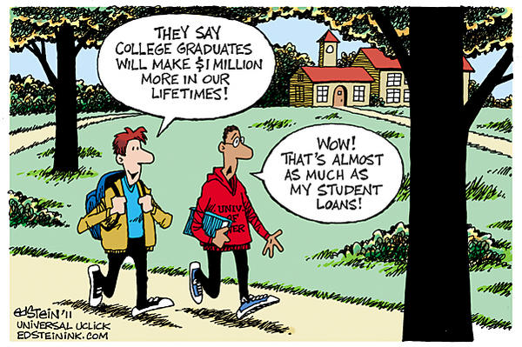
Activity
Activity-using whatever platform you like have the students discuss how they plan to go to college; if parents are paying, which many will, have the students think outside their box and figure out how they could go to school without mom and dads help; also have them look into the actual cost of attending the schools that they are interested in, many students don't actually realize how expensive it is.

